Slide 1
Capstone Engagement
Assessment, Analysis, and Hardening of a Vulnerable System
By: Dharani Kumar Krishnan

Slide 2
Table of Contents
This document contains the following sections:
01
Network Topology
02
Red Team: Security Assessment
03
Blue Team: Log Analysis and Attack Characterization
Hardening: Proposed Alarms and Mitigation Strategies
04

Slide 3
Network Topology
3

Slide 4
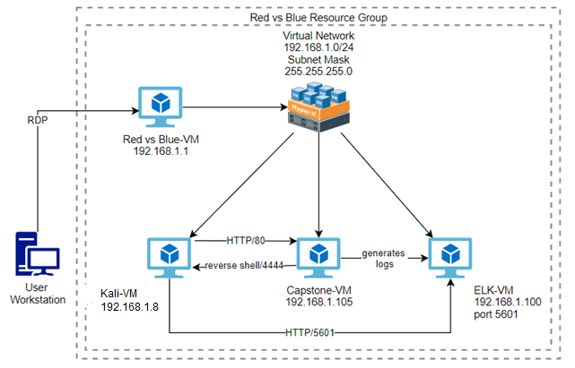
Network Topology
Network
Address Range: 192.168.1.0/24
Netmask:
255.255.255.0
Gateway:
192.168.1.1
Machines
IPv4: 192.168.1.1
OS: Windows XP/7/2008
Hostname: Red vs Blue-VM
IPv4: 192.168.1. 8
OS: Kali Linux
Hostname: Kali-VM
IPv4: 192.168.1.100
OS: Linux
Hostname: ELK-VM
IPv4: 192.168.1.105
OS: Linux
Hostname: Capstone-VM

Slide 5

Red Team
Security Assessment
5

Slide 6
Recon: Describing the Target
Nmap identified the following hosts on the network:
Hostname | IP Address | Role on Network
Azure Host Machine | 192.168.1.1 | Windows 10 Hyper-V gateway
Kali Linux | 192.168.1.8 | Penetration Tester
Server 1 (Capstone) | 192.168.1.105 | Target running the vulnerable Apache web server.
Elk | 192.168.1.100 | SEIM the Elastic Search, Logstash, Kibana.

Slide 7
Vulnerability Assessment
The assessment uncovered the following critical vulnerabilities in the target:
Vulnerability | Description | Impact
Web Server Directory List | Directory listing is a web server function that displays the directory contents when there is no index file in a specific website directory or when the function is left on. | It is dangerous to leave this function turned on because it leads to information disclosure on the web server. Ex. exposed folder structures and files.
Vulnerable Password | Brute Force Attack in this case is when a wordlist is used against a user to guess/submit many passwords in order to find ultimately find the password that belongs to a user. | The attacker used a Brute Force Attack which allowed them to crack and gain user Ashton’s password.
PHP Reverse TCP Shell Script | Executable file (payload) that can be uploaded to the web server. | The attacker was able to upload a PHP reverse shell script using WebDav to gain access to the web server to then execute it.

Slide 8
Vulnerability Assessment
The assessment uncovered the following critical vulnerabilities in the target:
Vulnerability | Description | Impact
Information easily gathered via publicly accessible server | The corporate server exposes a lot of information about employees and network resources. | This info can be used to make attacks easier, as usernames are based on first names of employees.
WebDav enabled | WebDav is enabled without any protection against brute force attack | Upon exploitation, an adversary may upoload/modify files, threatening the integrity of its content

Slide 9
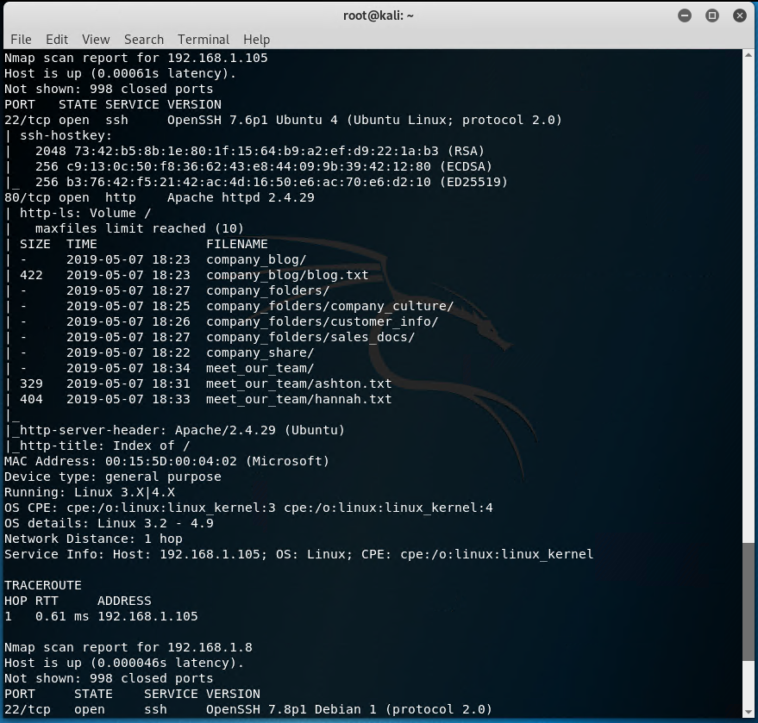
Exploitation: Webserver Directory Listing
01
02
03
Tools & Processes
ifconfig:
Used to discover the Kali Linux machine IP to then discover the subnet.
Nmap:
Used to scan all IPs on the network (knowing the subnet from ifconfig) to return machines and services running.
Achievements
Uncovered:
Apache server located at 192.168.1.105.
The list of directories on the Apache server in the Nmap result.
The open ports of 22 and 80.

Slide 10
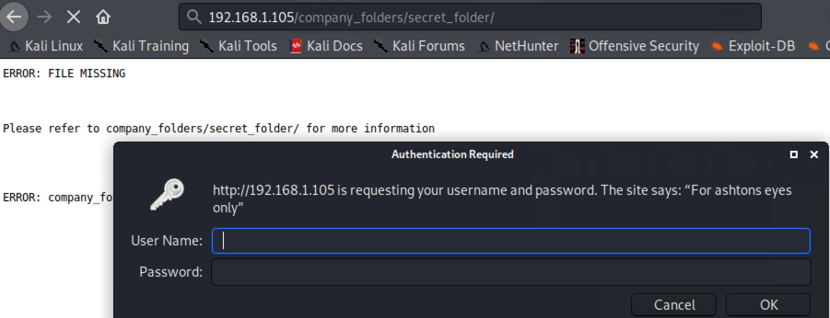
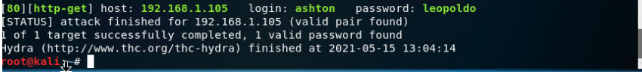
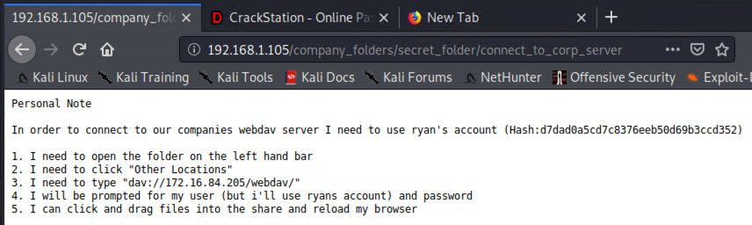
Exploitation: Vulnerable Password
01
02
03
Tools & Processes
Hydra:
Used to to run a list of common passwords against user Ashton.
Wordlist:
In this case rockyou.txt was used to brute force attack user Aston’s password with Hydra.
Achievements
Hydra cracked user Ashton’s password with the wordlist.
Authentication into secret_folder that user Ashton had to access to.
Uncovered:
A “Personal Note” was then found with user Ryan’s credentials to the server.

Slide 11
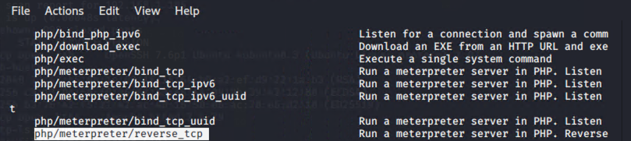
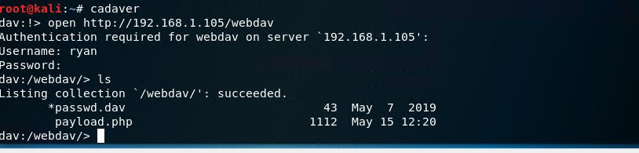
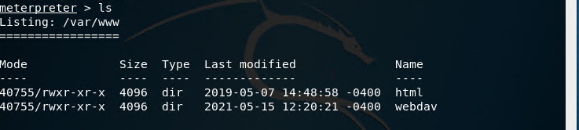
Exploitation: PHP Reverse TCP Shell Script
01
02
03
Tools & Processes
Metasploit / MSFvenom:
Used MSFvenom (in Metasploit) to find a PHP reverse TCP shell script, create a shell.php payload and Meterpreter session.
Cadaver:
Used to connect to the Apache server and add shell.php payload.
Achievements
Successfully added the PHP reverse TCP payload script (shell.php) to the server.
Created a Meterpreter session to the server.
Uncovered:
Root access, more directories on the server and a flag.txt.

Slide 12

Blue Team
Log Analysis and Attack Characterization
12

Slide 13
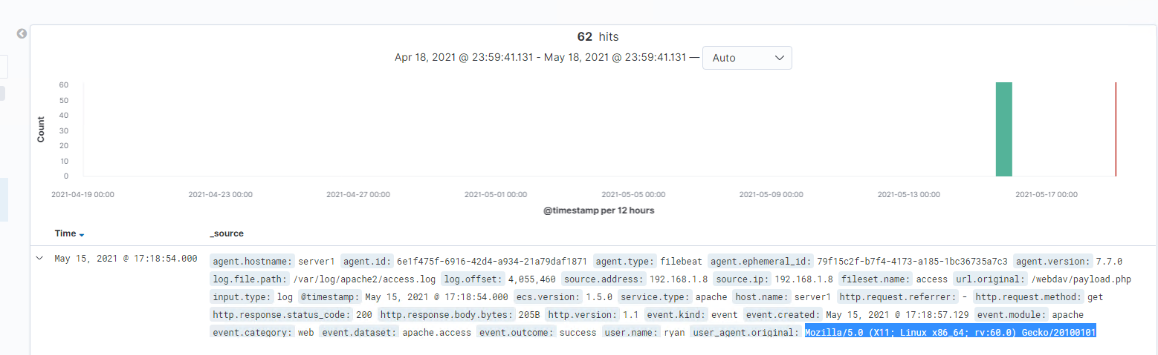
Analysis: Identifying the Port Scan
The port scan occured between 17:18 (5:18pm).
62 packets were sent to IP 192.168.1.8 (attacker).
Based on port scan User Agent was a Linux Machine.
Summary of Analysis

Slide 14
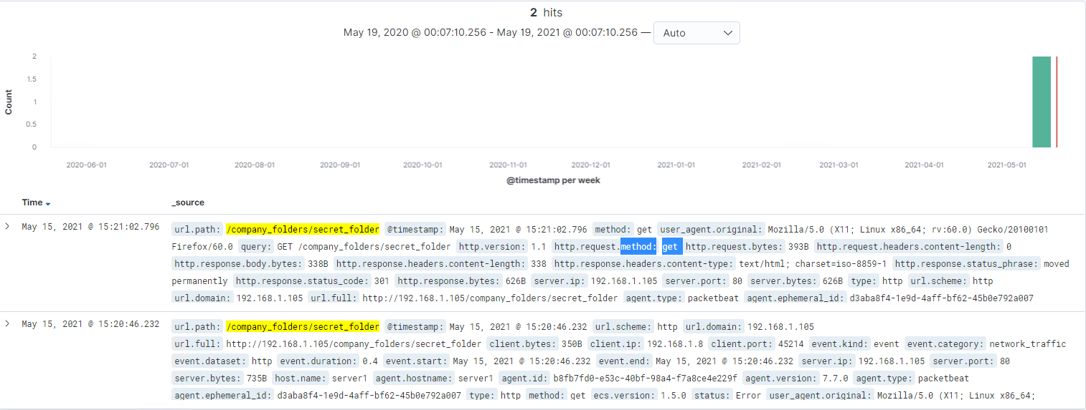
Analysis: Finding the Request for the Hidden Directory
Requested occurred at 15:21 (3:21 pm).
2 request were made to secret_folder.
The file requested was access.log and this secret_folder contained a “Personal Note” with user Ryan’s credentials and how to get to the server.
Summary of Analysis

Slide 15
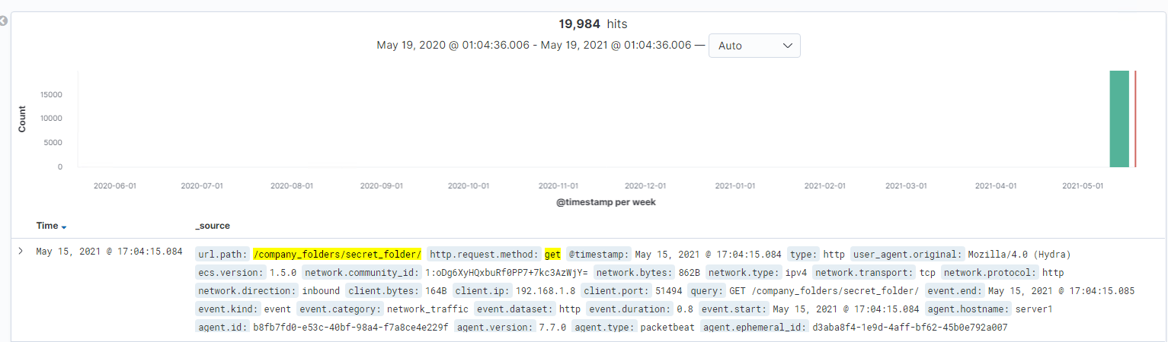
Analysis: Uncovering the Brute Force Attack
Summary of Analysis
19,987 requests were made in the attack.
19984 requests had been made before the attacker discovered the password.

Slide 16
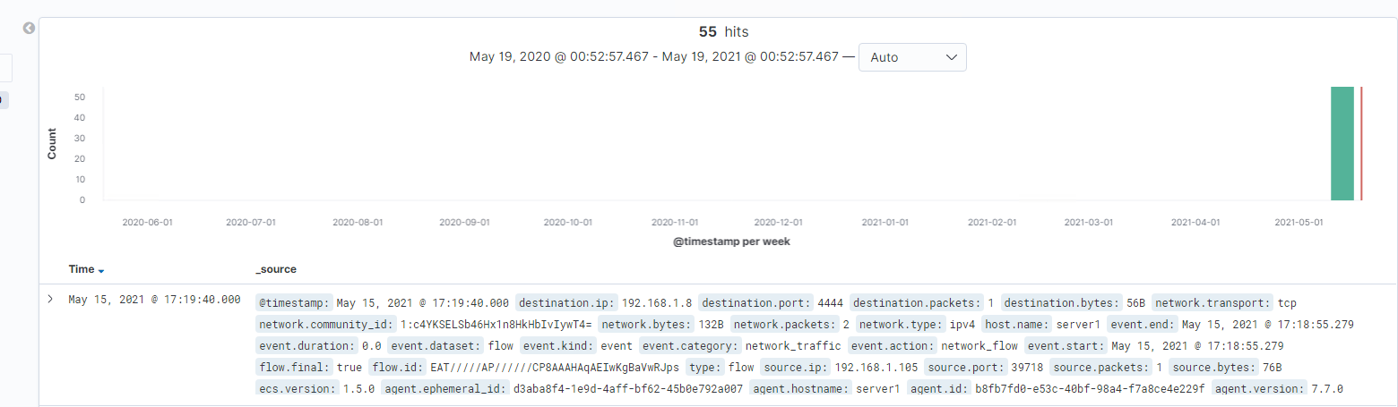
Analysis: Identifying the Reverse Shell The reverse shell was identified with the following Kibana script: ○ source.ip: 192.168.1.105 and destination.ip: 192.168.1.8 and destination.port > 0 and network.protocol: (not *) and http.response.body.bytes : (not *) and source.port: (not 80 or 22)

Slide 17
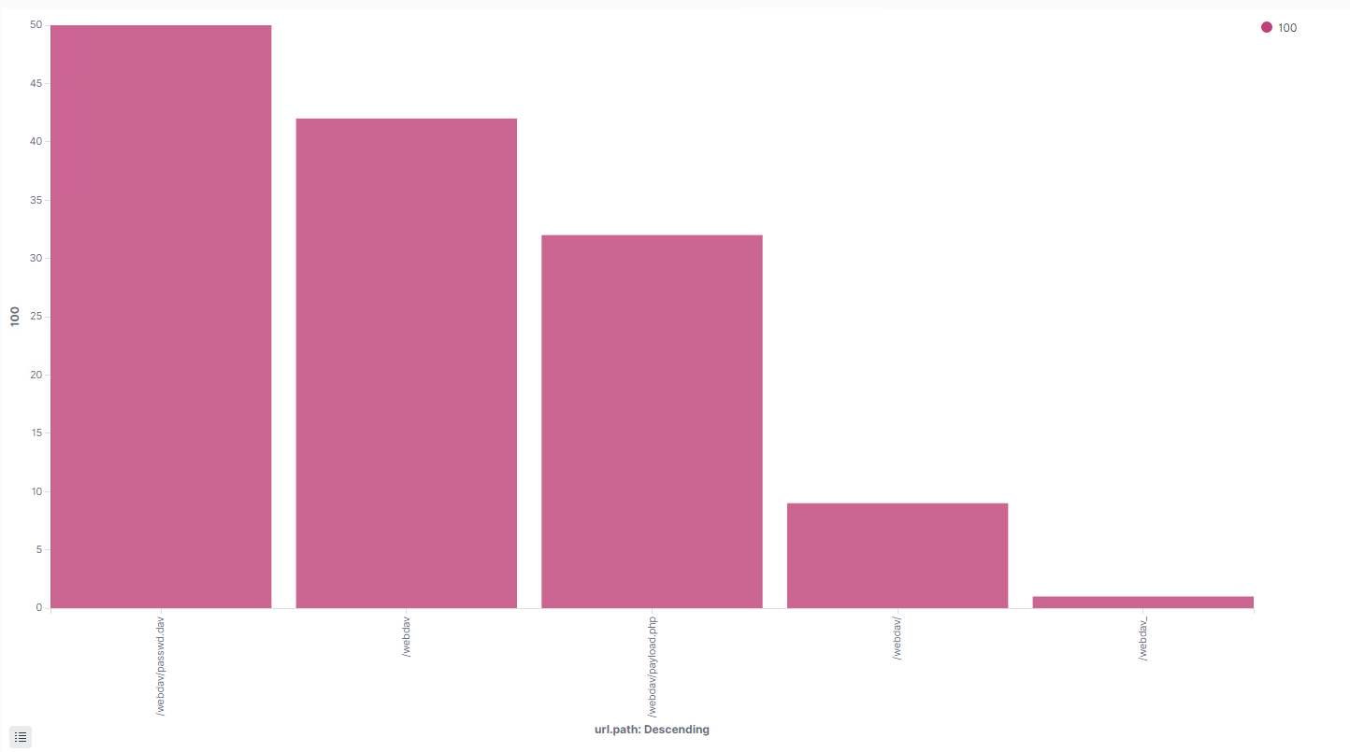
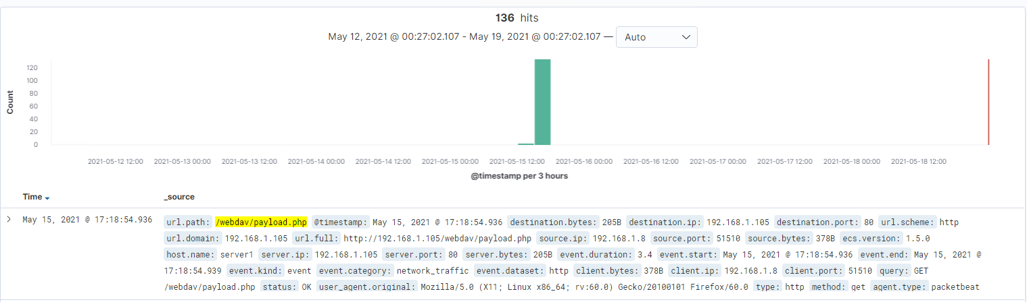
Analysis: Finding the WebDAV Connection
Summary of Analysis
136 request were made to the WebDav directory
The files requested were payload.php and passwd.dav

Slide 18
Blue Team
Proposed Alarms and Mitigation Strategies
18

Slide 19
Mitigation: Blocking the Port Scan
Alarm
System Hardening
What kind of alarm can be set to detect future port scans?
Search criteria:
destination.ip: 192.168.1.105 and source.ip: (not
192.168.1.105) and destination.port: (not 443 or 80)
Report criteria:
Number of ports accessed per source IP per second.
What threshold would you set to activate this alarm?
Thresholds that activate the alarm:
Alert email and log when > 3 none port 403 or port 80 scans detected at the same timestamp from the same IP occur.
What configurations can be set on the host to mitigate port scans?
Create / add a rule in to a firewall or IDS to block any IP address that attempts to access more than 3 ports.
Create / add a deny list of User Agents to be applied to firewall rules or an IDS.
Close off any ports that are non essential to business.

Slide 20
Mitigation: Finding the Request for the Hidden Directory
Alarm
System Hardening
What kind of alarm can be set to detect future unauthorized access?
Search criteria:
http.request.method : "get" and user_agent.original
:"Mozilla/4.0 (Hydra)" and url.path :"/company_folders/secret_folder/" and status :(Error or OK)
Report criteria:
Number of times Error (401) response detected in 10 second interval..
What threshold would you set to activate this alarm?
Thresholds that activate the alarm:
Alert email and log when, on protected files and folders, > 5 Error (401) responses occur at any time OR any OK (200) responses occur from non-trusted IPs
What configuration can be set on the host to block unwanted access?
Modify your configuration file on the host to block
unwanted access to the “secret_folder” from any IP other
than those listed and disable dir listings:
Open your httpd.conf file:
> nano /etc/httpd/conf/httpd.conf
* Locate directory section (/var/www/) and set it as follows:
<Directory /var/www/company_folders/secret_folder/>
Order allow,deny
Allow from 192.168.1.1
Allow from 192.168.1.105
Allow from 127
Deny from 192.168.1.90
</Directory>
Turn off the directory listing:
In apache2.conf remove “Indexes” from <Directory /var/www/> </Directory> under “Options”

Slide 21
Mitigation: Preventing Brute Force Attacks
Alarm
System Hardening
What kind of alarm can be set to detect future brute force attacks?
Search criteria:
http.request.method : "get" and user_agent.original
:"Mozilla/4.0 (Hydra)" and url.path
:"/company_folders/secret_folder/" and status :(Error or
OK)
Report criteria:
Number of times Error (401) response detected in 10
second interval.
What threshold would you set to aAlert email and log when, on protected files and folders, > 5
Error (401) responses occur at any time OR any OK (200)
responses occur from non-trusted IPs
ctivate this alarm?
What configuration can be set on the host to block brute force attacks?
Create / add a access list of known IPs and devices to a firewall or IDS.
Create a rule to block any traffic returning an excess amount of 401 response codes.
Lockout an account with an excess amount of bad logins.
Add IPs or devices to a deny list if they are creating an excessive amount of traffic.
Set up Fail2ban in the fail2ban.conf and jail.conf files found in /etc folder.

Slide 22
Mitigation: Detecting the WebDAV Connection
Alarm
System Hardening
What kind of alarm can be set to detect future access to this directory?
Alarms can be set off when:
Search criteria:
http.request.method : * and url.path: *webdav* and source.ip: (not 192.168.1.150 or 192.168.1.1)
What threshold would you set to activate this alarm?
Thresholds that activate the alarm:
Alert email and log when requests are made, on protected files and folders, from non-trusted IPs
What configuration can be set on the host to control access?
Modify your configuration file on the host to block
unwanted access to the “webdav” from any IP other
than those listed:
Open your httpd.conf file:
> nano /etc/httpd/conf/httpd.conf
Locate directory section (/var/www/) and set it as follows:
<Directory /var/www/webdav/>
Order allow,deny
Allow from 192.168.1.1
Allow from 192.168.1.105
Allow from 127
Deny from all
</Directory>

Slide 23
Mitigation: Identifying Reverse Shell Uploads
Alarm
System Hardening
What kind of alarm can be set to detect future file uploads?
Search criteria:
http.request.method : “put” and url.path: *webdav* and
source.ip: (not 192.168.1.1 or 192.168.1.105)
NOTE: Also Reverse Shell Signature for Consideration of
Reverse Shell Detection:
source.ip: 192.168.1.105 and destination.ip: (not 192.168.1.1
or 192.168.1.105) and destination.port > 0 and
network.protocol: (not *) and http.response.body.bytes: (not
*) and source.port: (not 80 or 22)
Report criteria:Count directory “put” method from non-trusted IPs.
What threshold would you set to activate this alarm?
Alert email and log when “put” request methods are made,
on protected folders, from non-trusted IPs
What configuration can be set on the host to block file uploads?
Modify your configuration file on the host to block
unwanted access to the “secret_folder” from any IP
other than those listed:
Open your httpd.conf file:
> nano /etc/httpd/conf/httpd.conf (location may vary)
Locate directory section (/var/www/) and set it as follows:
<Directory /var/www/webdav/>
Order allow,deny
Allow from 192.168.1.1
Allow from 192.168.1.105
Allow from 127
Deny from all
<LimitExcept GET POST HEAD>deny from all
</LimitExcept>
</Directory>

Slide 24
Takeaways

Slide 25
Takeaways
As a company, it is important to think, not if a security breach will occur, but when.
RED TEAM:
● Opened Port 80
● Accessed Sensitive Files
● Brute-Forced to Gain Access
● Un-hashed Password to Gain Access and Inject a Shell Script
BLUE TEAM:
● Identified Port Scan
● Found Request for Hidden Directory
● Uncovered the Brute Force Attack
● Found the WebDav Connection
Continuous monitoring and communication between the security team and the employees will ensure swift response and prevention to attacks.

